Slide 1

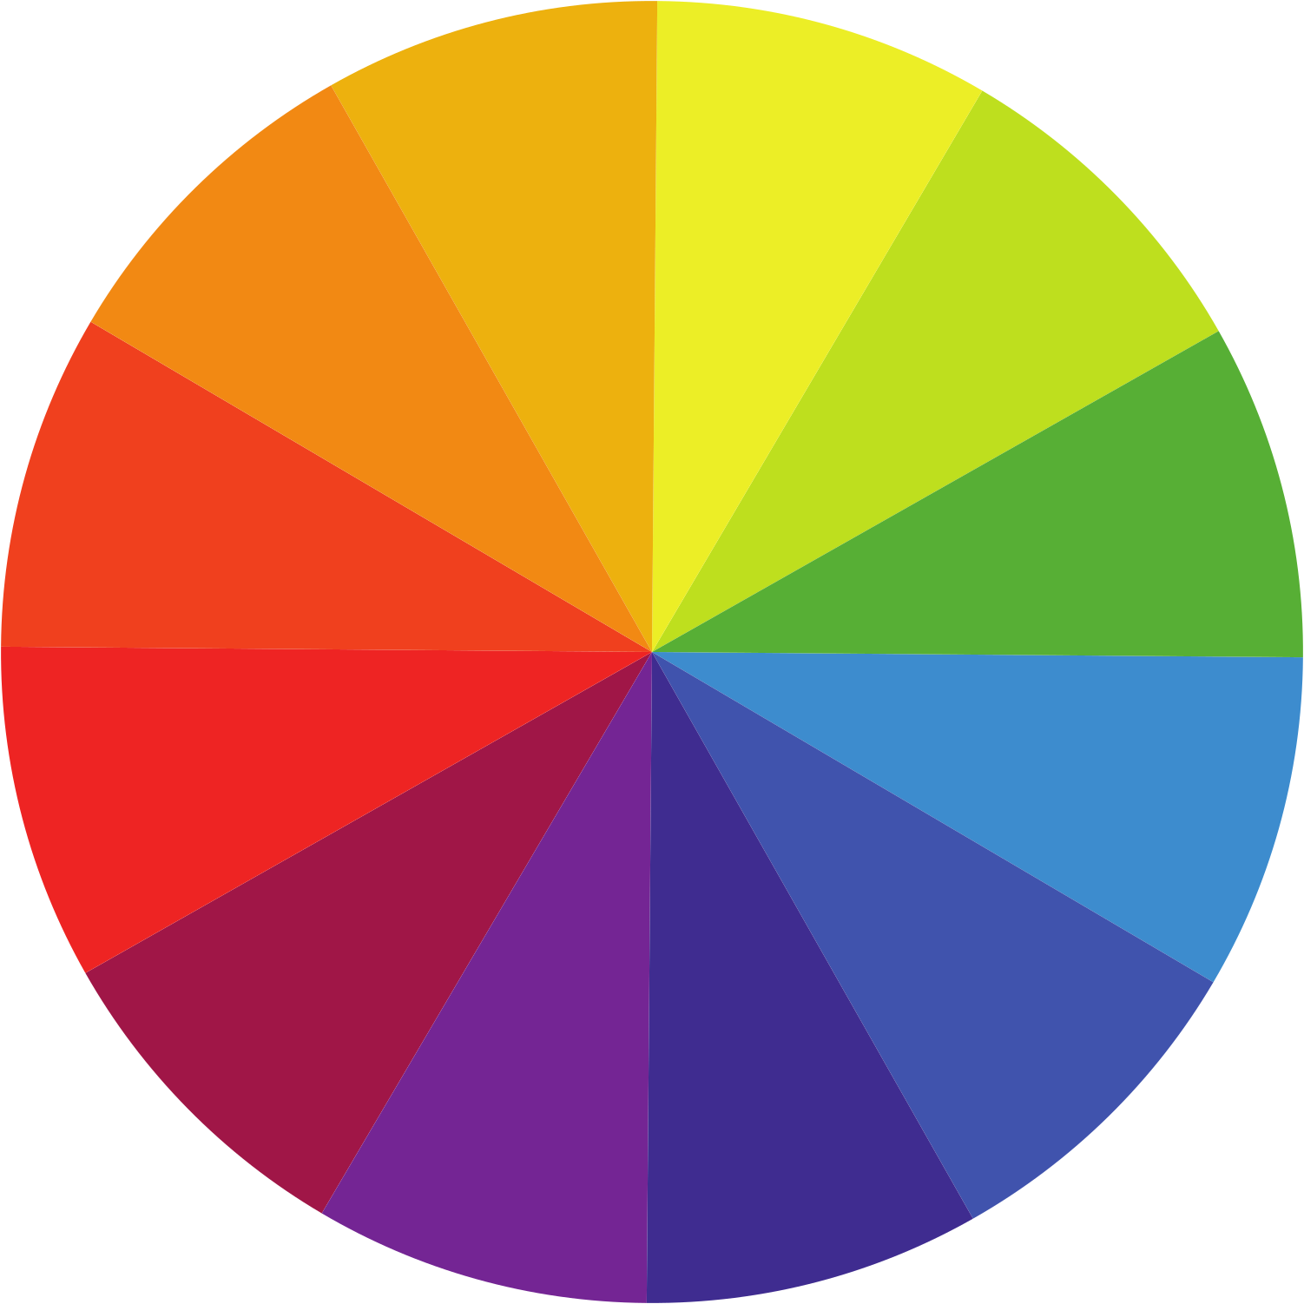
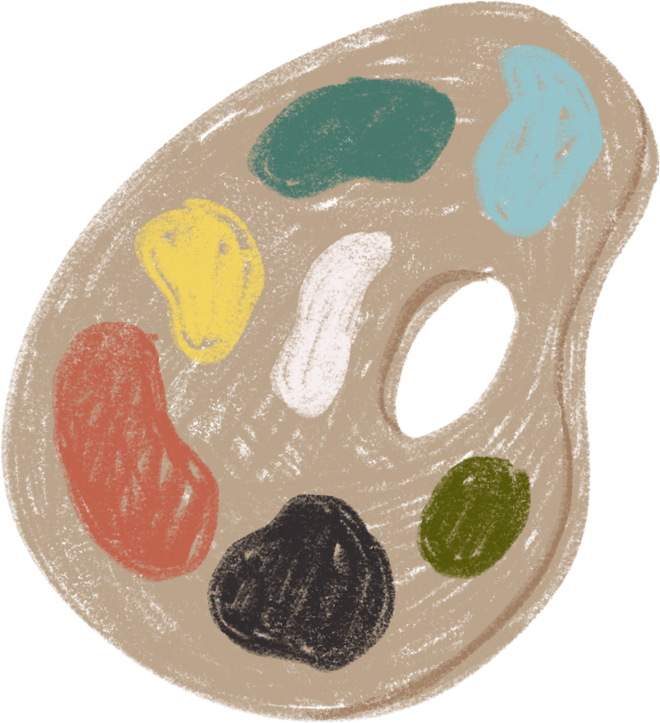

COLOUR
WHEEL
COMPLEMENTARY
COLOURS

Slide 2



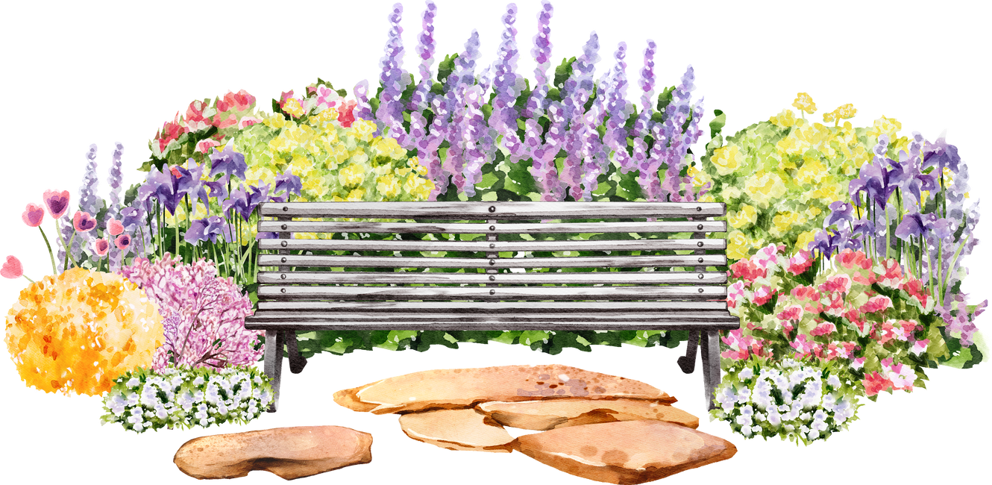

COLOUR IS EVERYWHERE

Slide 3
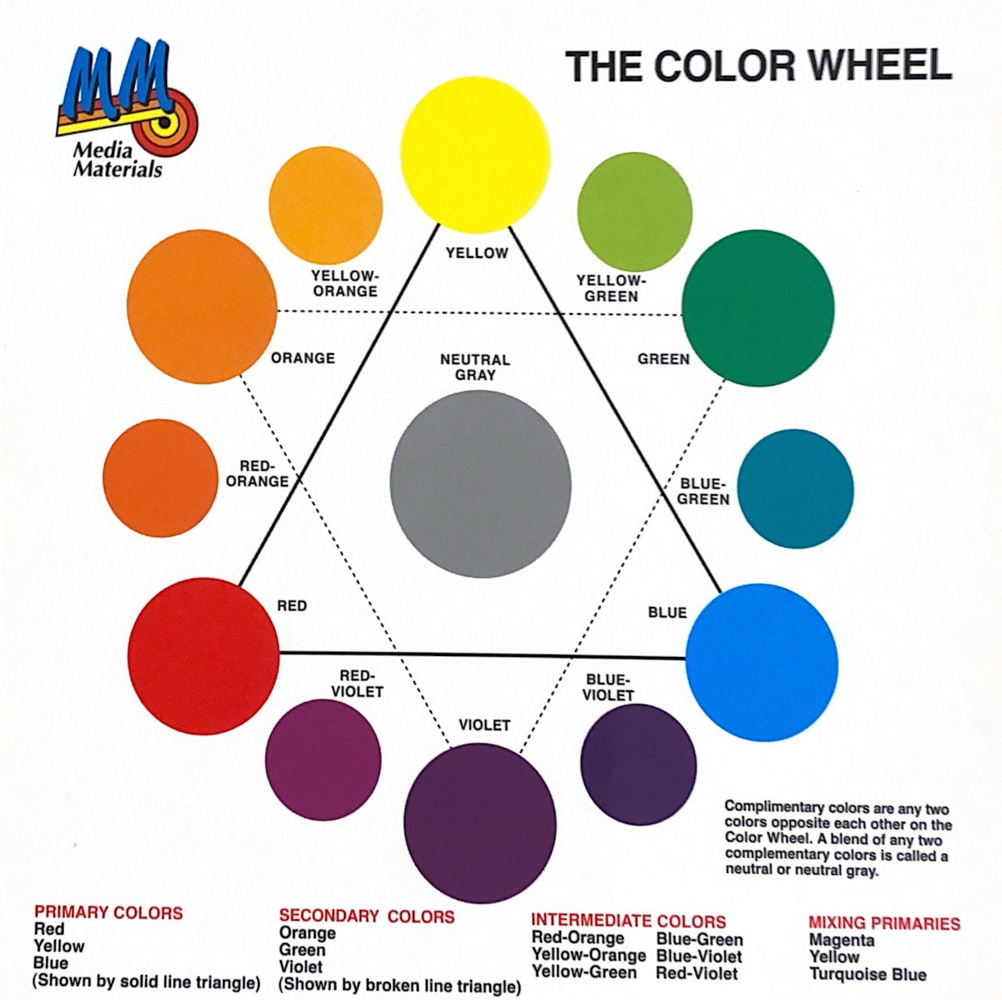
THE COLOUR WHEEL

Slide 4
THE COLOUR WHEEL

Slide 5

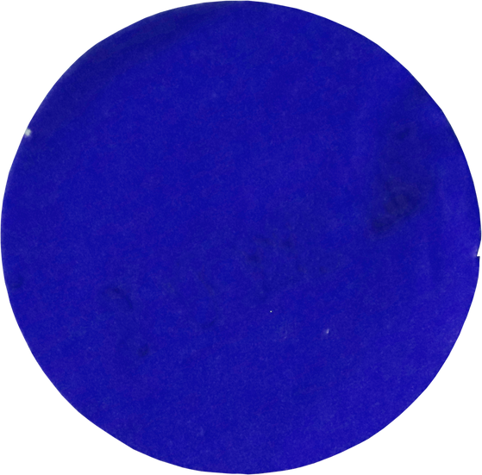



WHAT COLOUR WILL THEY MAKE?
Red
Primary
Blue
Primary

Slide 6

WHAT COLOUR WILL THEY MAKE?
Red
Primary
Blue
Primary
Violet

Slide 7


WHAT COLOUR WILL THEY MAKE?
Yellow
Primary
Green
Secondary

Slide 8

WHAT COLOUR WILL THEY MAKE?
Yellow
Primary
Green
Secondary
Yellow-Green

Slide 9
WHAT COLOUR WILL THEY MAKE?
Red
Primary
Green
Secondary

Slide 10

WHAT COLOUR WILL THEY MAKE?
Red
Primary
Green
Secondary
Grey
Neutral

Slide 11

WHAT COLOUR WILL THEY MAKE?
Red-Violet
Intermediate/Tertiary
Yellow-Green
Intermediate/Tertiary

Slide 12
WHAT COLOUR WILL THEY MAKE?
Red-Violet
Intermediate/Tertiary
Yellow-Green
Intermediate/Tertiary
Grey
Neutral

Slide 13
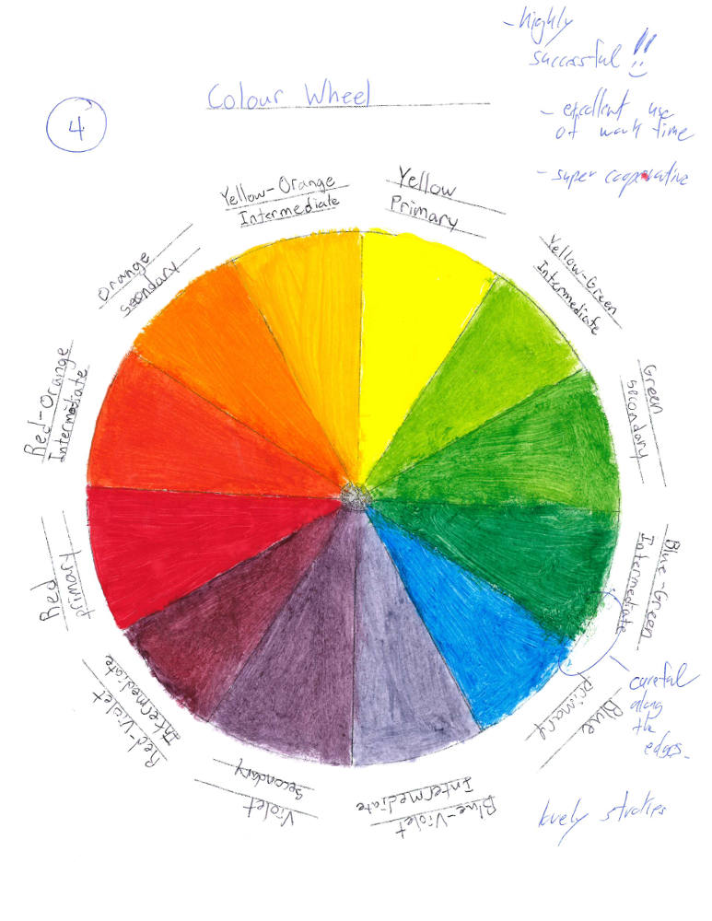
MAKING YOUR OWN COLOUR WHEEL
  Mix your own colours.
  Mix them on the palette, NOT on the painting.
  Use primary colours: Red, Blue & Yellow to create the colours.
  Don't get it too wet. It will get soggy & not look nice.
  Be sure to paint inside the lines.
  Have the paint strokes in one direction.
  Don't waste paint. Help with set up /clean up.

