Slide 1
Cartograms

Slide 2
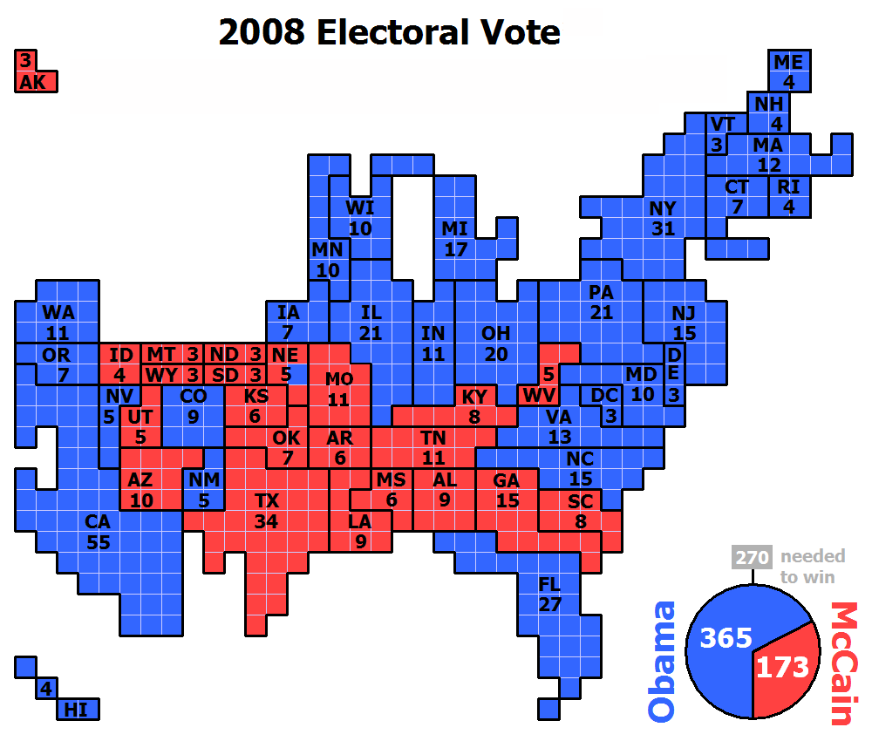
Introduction to Cartograms
What does this map show?
Why is it distorted?
Who would find this map useful?

Slide 3
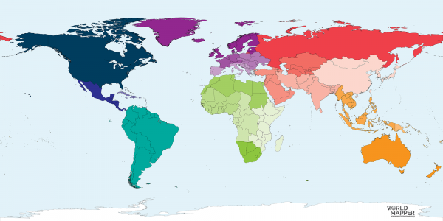
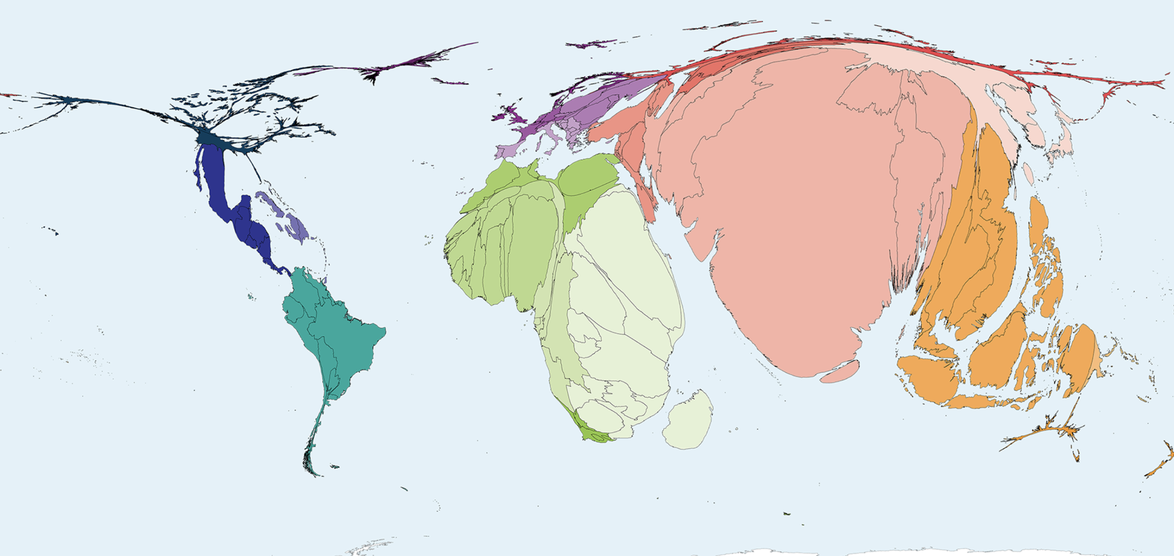
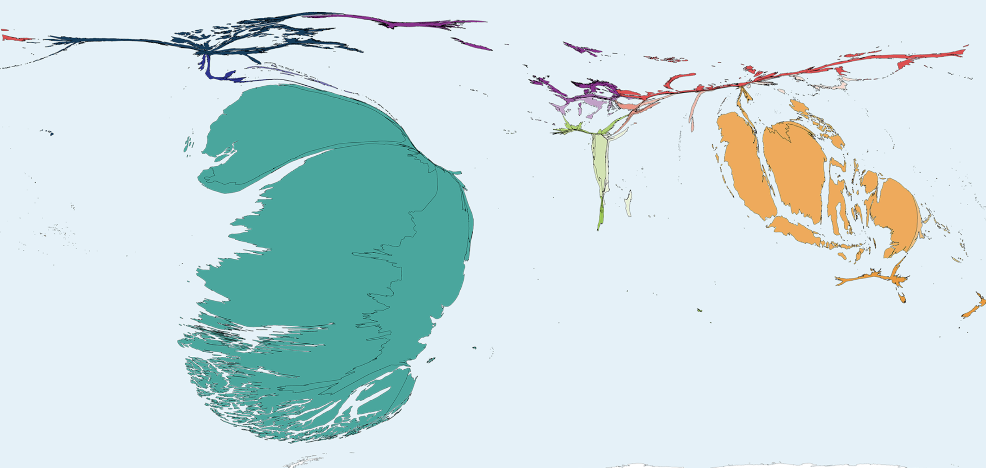
Introduction to Cartograms
A cartogram is a map in which the size of geographical areas are changed to be proportional to a variable
Each geographical location will either be inflated or deflated from its true size
Agricultural workers
Volcanic eruptions damages

Slide 4
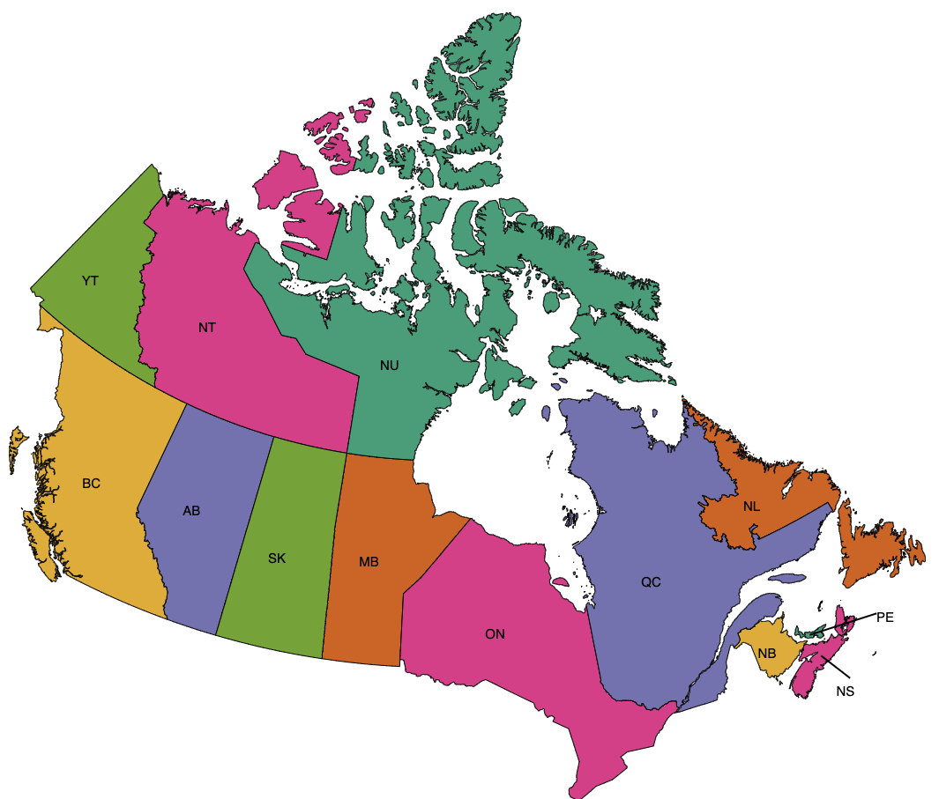
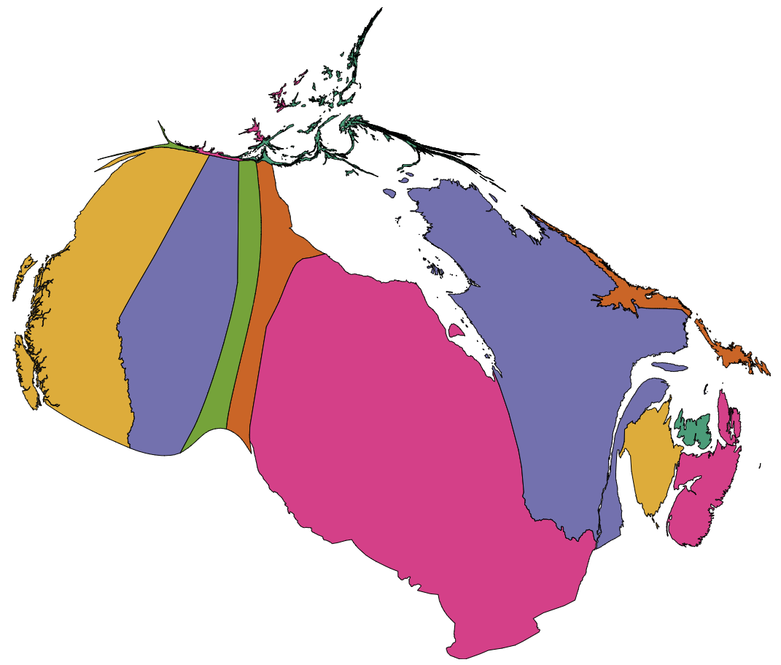
Introduction to Cartograms
Regular map of Canada
Cartogram displaying population for Canadian provinces and territories

Slide 5
Let’s analyze some cartograms together!

Slide 6
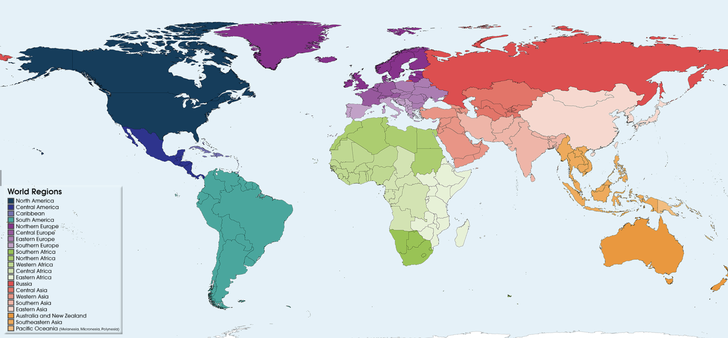
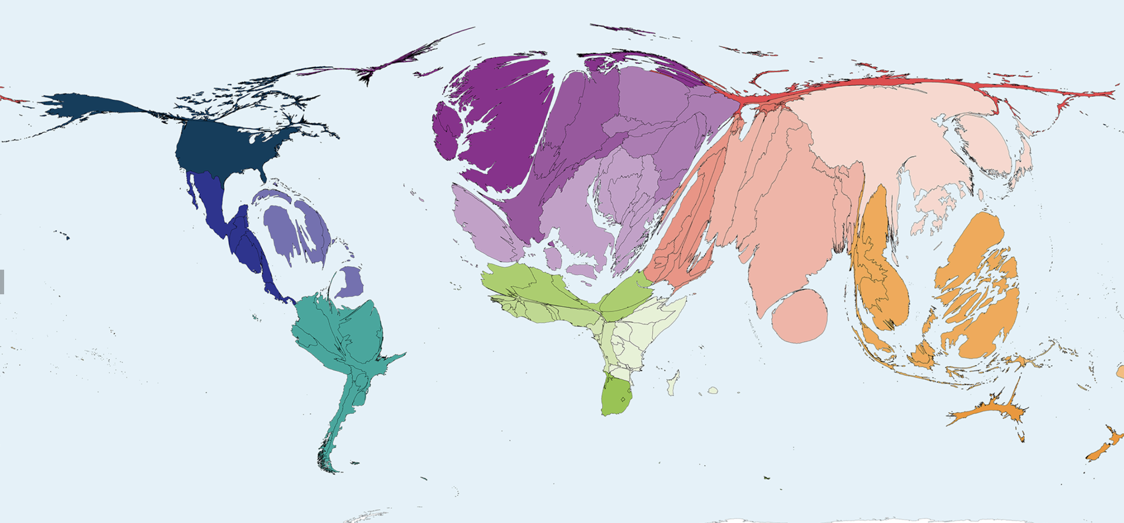
#1: Migration to Canada
Regular map of the world
Cartogram displaying the country of origin of people migrating to Canada

Slide 7
#1: Migration to Canada
What information does this cartogram provide us with?
Which countries are larger? Which countries are smaller?
Why might people be more or less willing to migrate to Canada from their country?
Did interpreting this cartogram change your view of the world? Explain.
The country of origin of people migrating to Canada

Slide 8
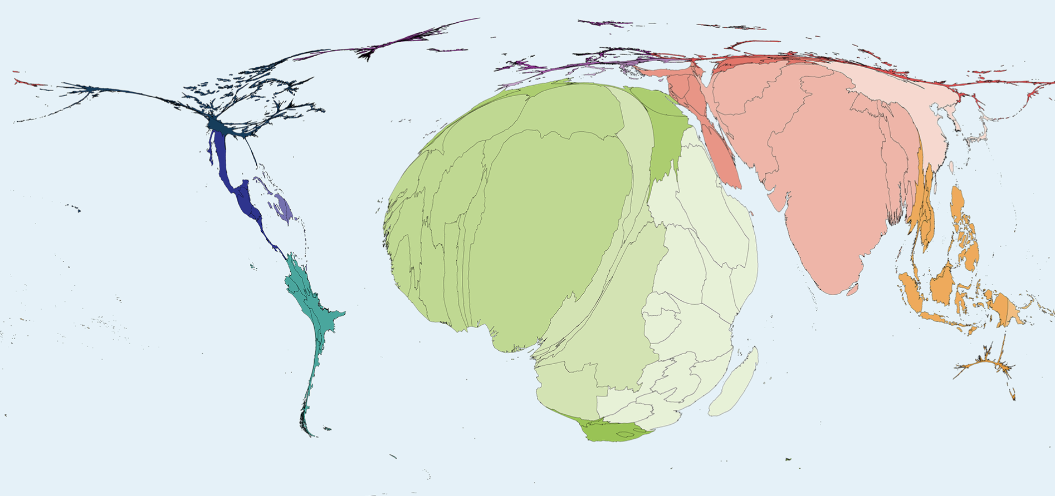
#2: Deaths From Ages 1 - 4
Regular map of the world
Cartogram displaying the number of deaths of children ages 1 through 4

Slide 9
#2: Deaths From Ages 1 - 4
What information does this cartogram provide us with?
Who would need this information and why?
What can we infer about access to healthcare and other essential resources?
Did interpreting this cartogram change your view of the world? Explain.
The number of deaths of children ages 1 through 4

Slide 10
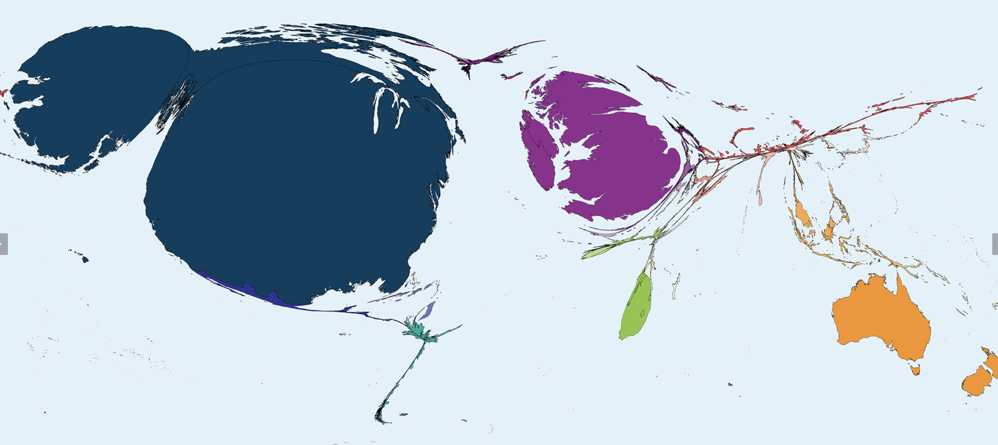
#3: English as a First Language
Regular map of the world
Cartogram displaying the number of people who speak English as their first language

Slide 11
#3: English as a First Language
What information does this cartogram provide us with?
Does this data influence your decision regarding which countries you would be willing to live in?
The number of people who speak English as
their first language

Slide 12
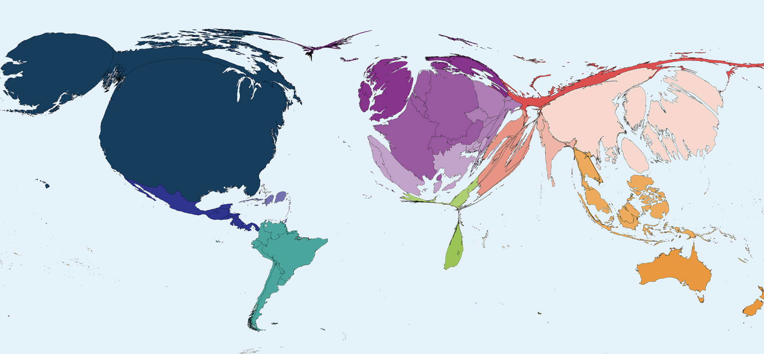
#4: McDonald’s Restaurants
Regular map of the world
Cartogram displaying the number of McDonald’s restaurants in 2018

Slide 13
#4: McDonald’s Restaurants
What information does this cartogram provide us with?
Which countries are larger? Which countries are smaller?
What might we be able to infer about the people that live in these countries?
The number of McDonald’s restaurants in 2018

Slide 14
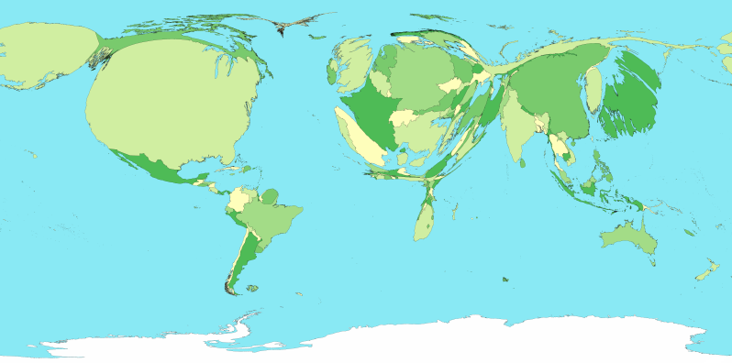
#4: McDonald’s Restaurants
The number of McDonald’s restaurants in 2018
Total spending on healthcare
Do you see a link between these two cartograms?
Does this make sense? Why or why not?

Slide 15
Review Questions
True or false: Cartograms always accurately showcase the true size of a region.
Fill in the blanks using the cartogram to the left.
  The continent of __________________ has the most damages due to volcanic eruptions.
  North America has _________ damages due to volcanic eruptions.
Volcanic eruptions damages
Notes:
False, they distort the true size of a region to show data.
South America
Very little

Slide 16

Making a Cartogram with Go-Cart
Let’s make a cartogram that represents the number of COVID-19 cases across the Canadian provinces and territories
https://go-cart.io/cartogram
Notes:
https://go-cart.io/cartogram
https://www.google.com/search?rlz=1C5CHFA_enCA803CA803&sxsrf=ALeKk03k7EKjIgzxwEE3jCapo-ow8HvKtw%3A1607917575581&ei=B-DWX82AI5aQtAbwy4qYDw&q=covid+19+cases+canada&oq=covid+19+cases+canada&gs_lcp=CgZwc3ktYWIQAzIECCMQJzIICAAQsQMQyQMyAggAMgIIADICCAAyAggAMgIIADICCAAyAggAMgIIADoECAAQRzoHCCMQyQMQJzoGCAAQFhAeOgUIABDJA1DbhhVY0JEVYMSTFWgAcAJ4AIABa4gBjweSAQM5LjGYAQCgAQGqAQdnd3Mtd2l6yAEGwAEB&sclient=psy-ab&ved=0ahUKEwiNoK7fx8ztAhUWCM0KHfClAvMQ4dUDCA0&uact=5

Slide 17
Assignment: Analyzing and Making Cartograms

