Slide 1
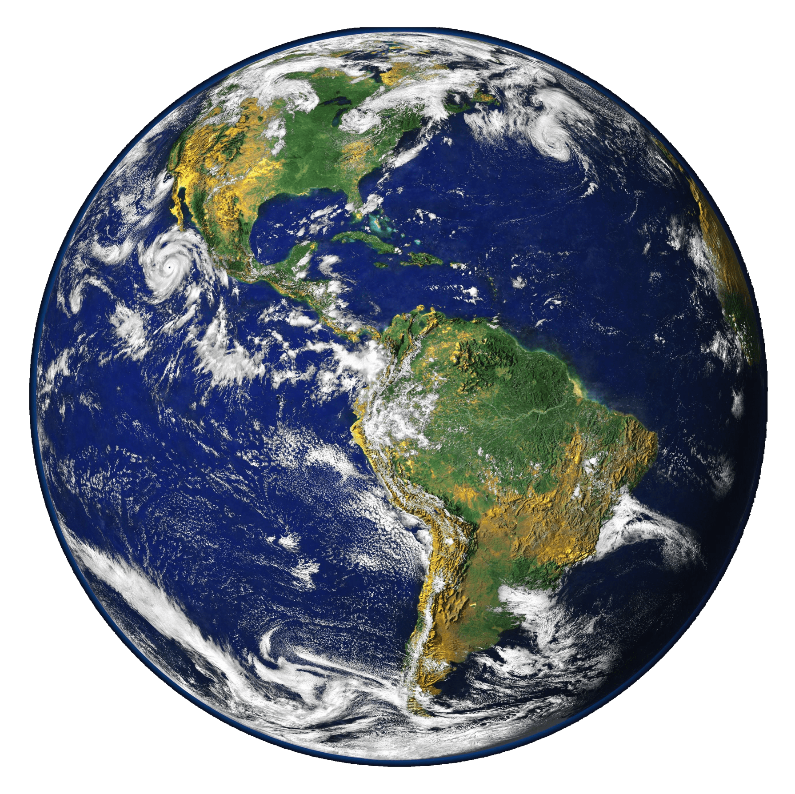
Climate Graphs
Notes:
Note: If the pencil icon is present in the top right-hand corner of a slide, it means there’s information on the slide that students need to copy onto their worksheets

Slide 2
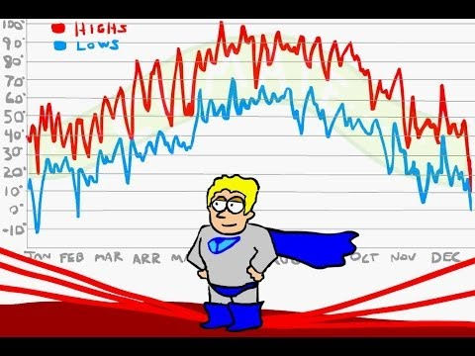
Climate vs. Weather
https://www.youtube.com/watch?v=VHgyOa70Q7Y (1:17)

Slide 3


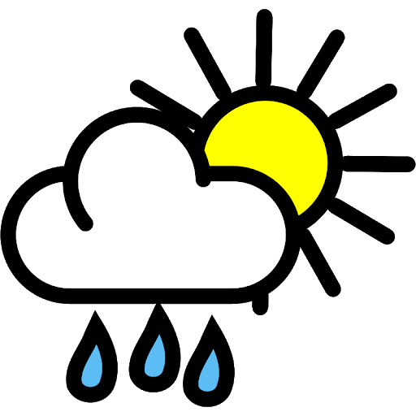
Climate vs. Weather
What is climate?
  Seasonal weather patterns observed over many years for a specific area
  “Climate is what you expect”
What is weather?
  Short-term changes in the atmosphere (temperature, precipitation, cloudiness, wind, etc.)
  “Weather is what you get”

Slide 4
So, how can we record climate?

Slide 5
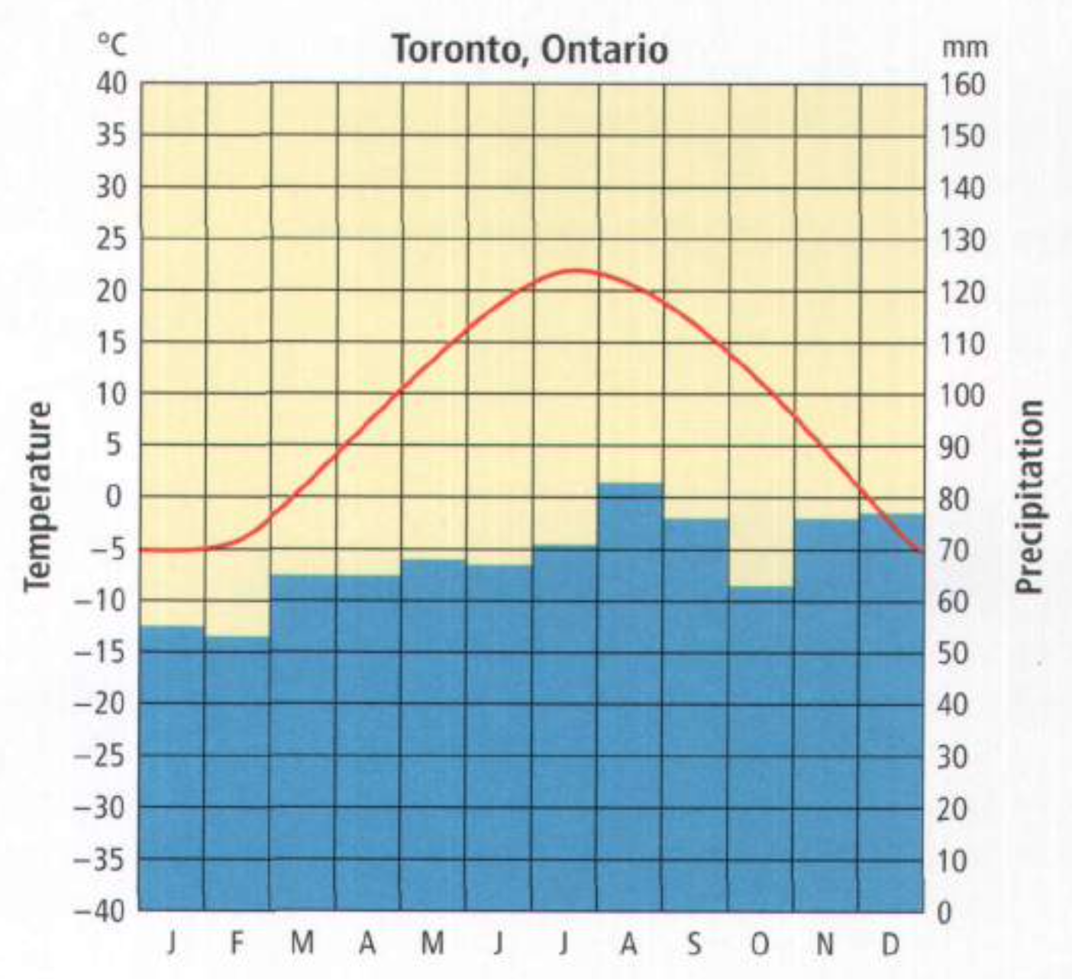
(2008)
Notes:
Get students to think independently for a minute or so, coming up with as many characteristics of climate graphs as they can
Then ask students to share their ideas with the class until all of the key elements are named

Slide 6
Key Elements of Climate Graphs
Top: Location and year
Bottom: Months
Line graph in red (average temperature for each month)
Left: Scale for average temperature (°C)
Bar graph in blue (total precipitation for each month)
Right: Scale for total precipitation (mm)
(2008)

Slide 7
Three Factors that
Influence Climate

Slide 8

#1: Northern vs. Southern Hemisphere
What are the hottest months in the Northern hemisphere?
What are the hottest months in the Southern hemisphere?
Why is this?
  June, July, and August
  December, January, and February
https://www.youtube.com/watch?v=b25g4nZTHvM (2:24)

Slide 9
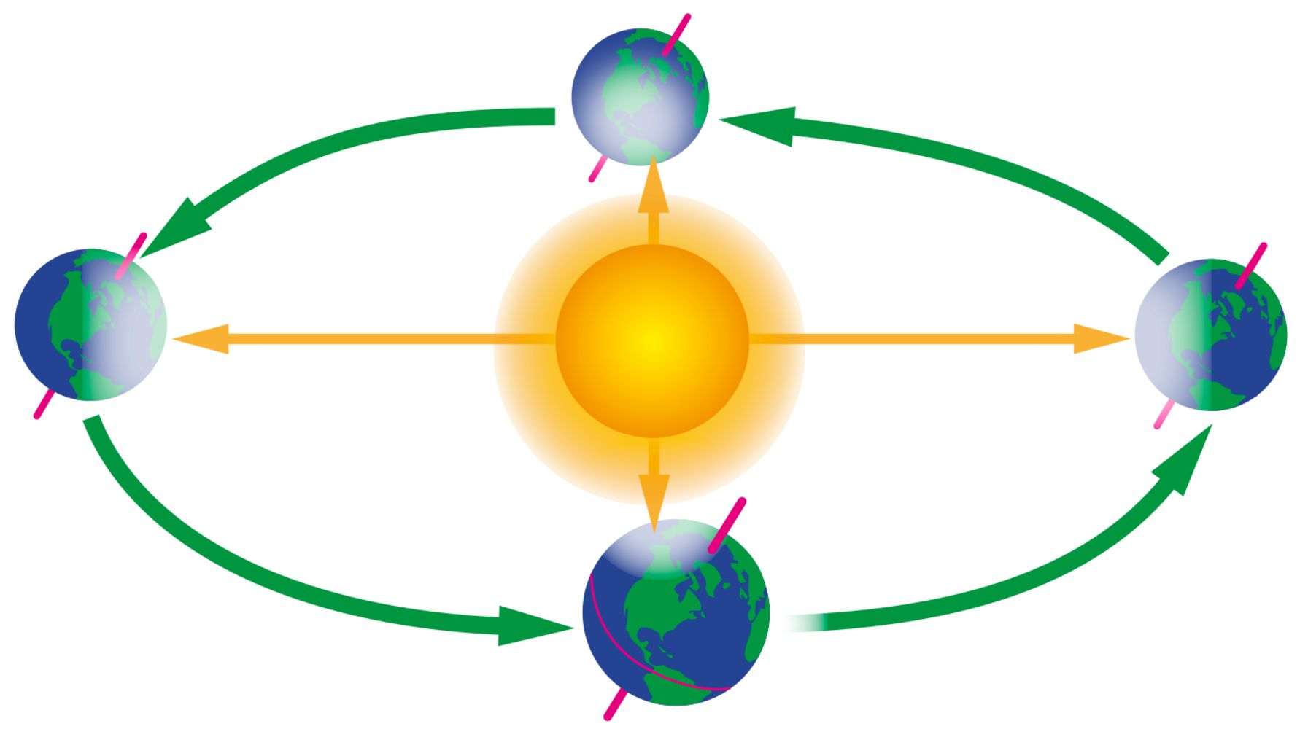
#1: Northern vs. Southern Hemisphere
Northern Hemisphere:
_______________________
Southern Hemisphere:
________________________
Northern Hemisphere:
_______________________
Southern Hemisphere:
________________________
Notes:
When the Northern hemisphere is tilted towards the sun, it’s summer there
When the Northern hemisphere is tilted away from the sun, it’s winter there

Slide 10
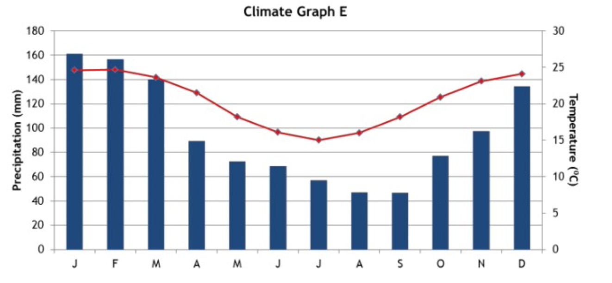
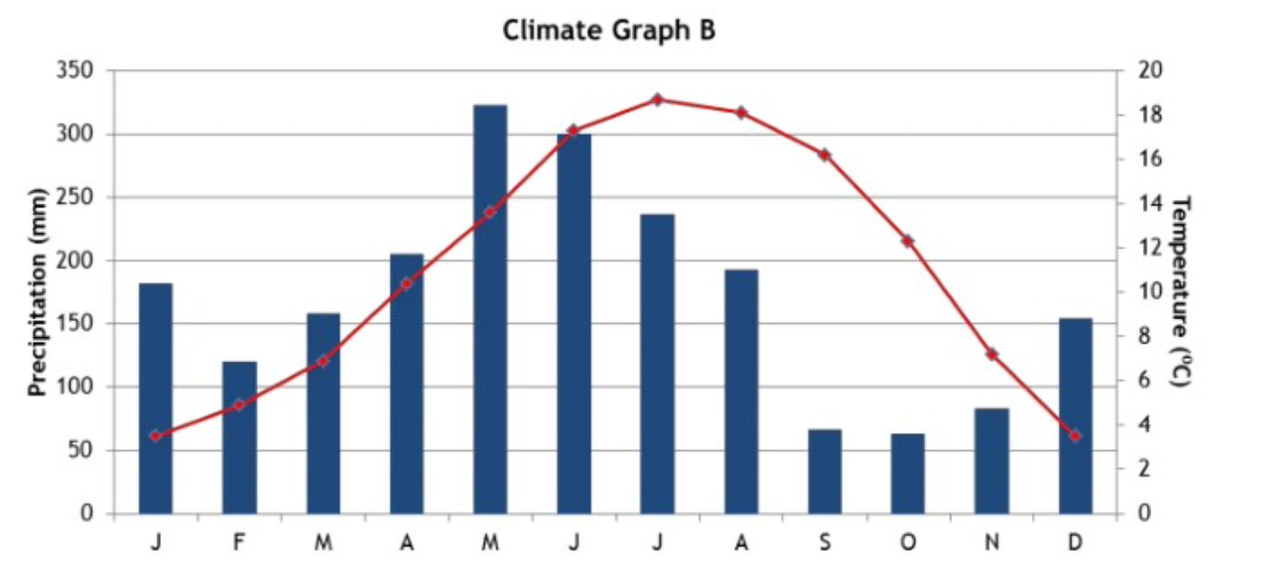
#1: Northern vs. Southern Hemisphere
Which climate graph is from a location in the Northern hemisphere and which one is from a location in the Southern hemisphere?
Notes:
Left: Southern hemisphere, coldest in June - August
Right: Northern hemisphere, warmest in June - August

Slide 11
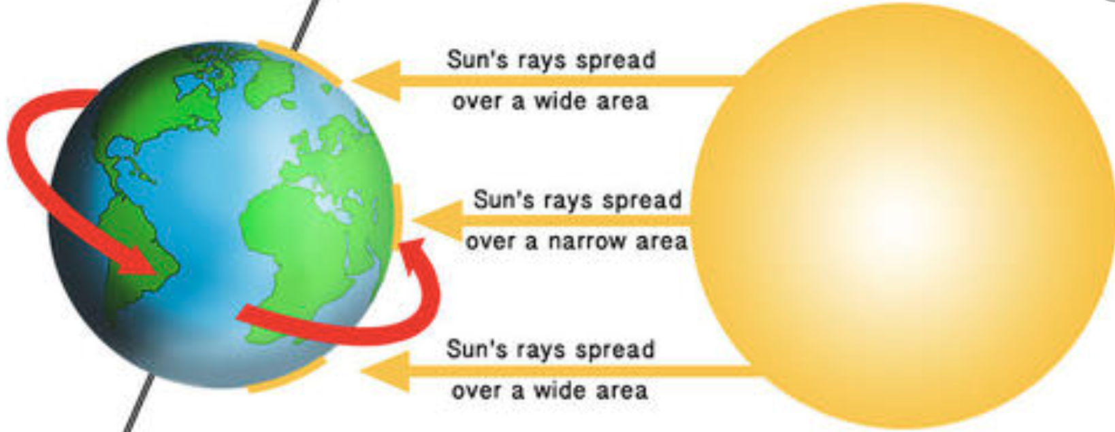
#2: Proximity to the Equator
Places close to the equator have more __________________ temperatures throughout the year
Places far away from the equator have more __________________ temperatures throughout the year
Notes:
Constant
Variable

Slide 12
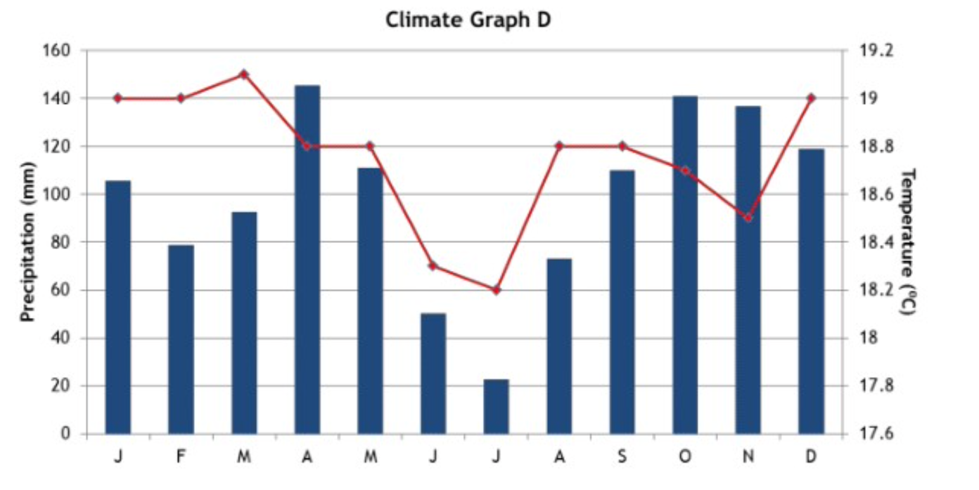
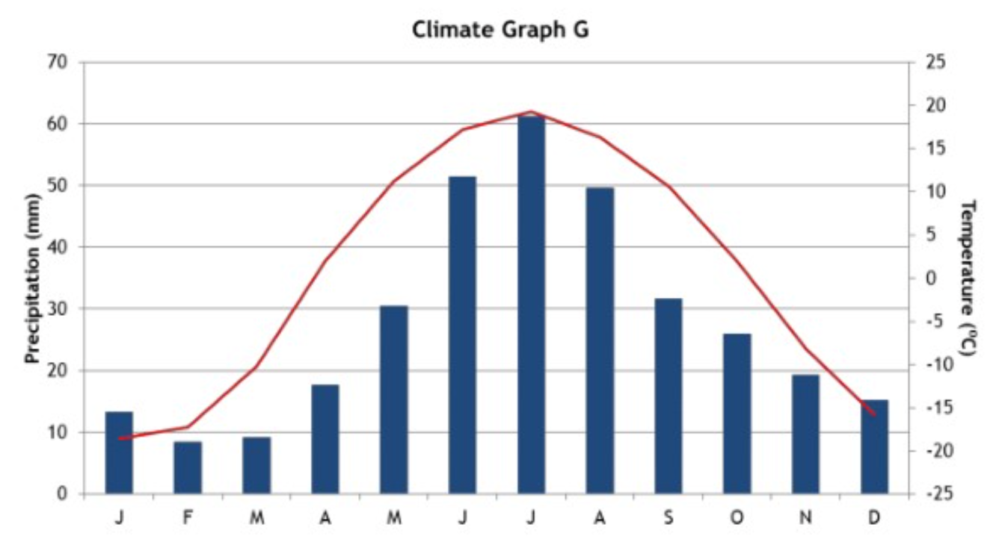
#2: Proximity to the Equator
Which climate graph is from a location close to the equator and which one is from a location far away from the equator?
Notes:
Point out to students that even though the temperature in the climate graph on the left looks like it’s changing a lot, the scale is much smaller so really there are only small differences
Left: Close to the equator, temperature is more constant
Right: Far away from the equator, temperature is more variable

Slide 13
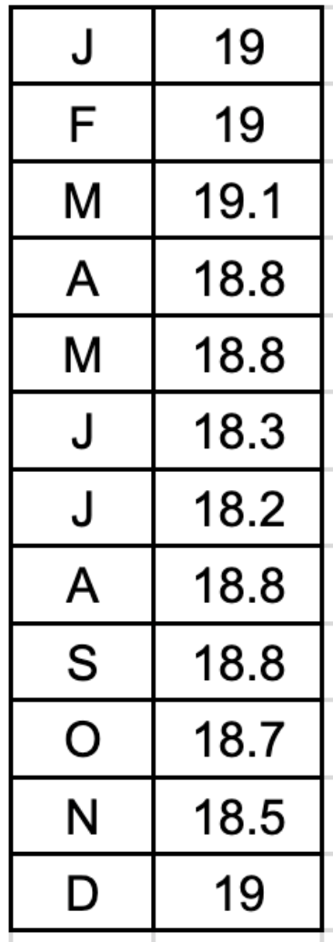
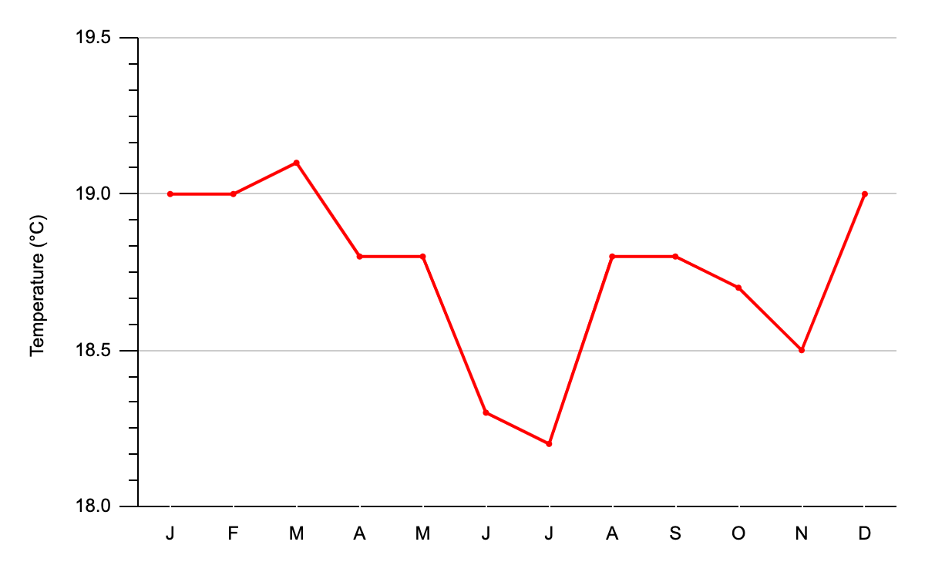
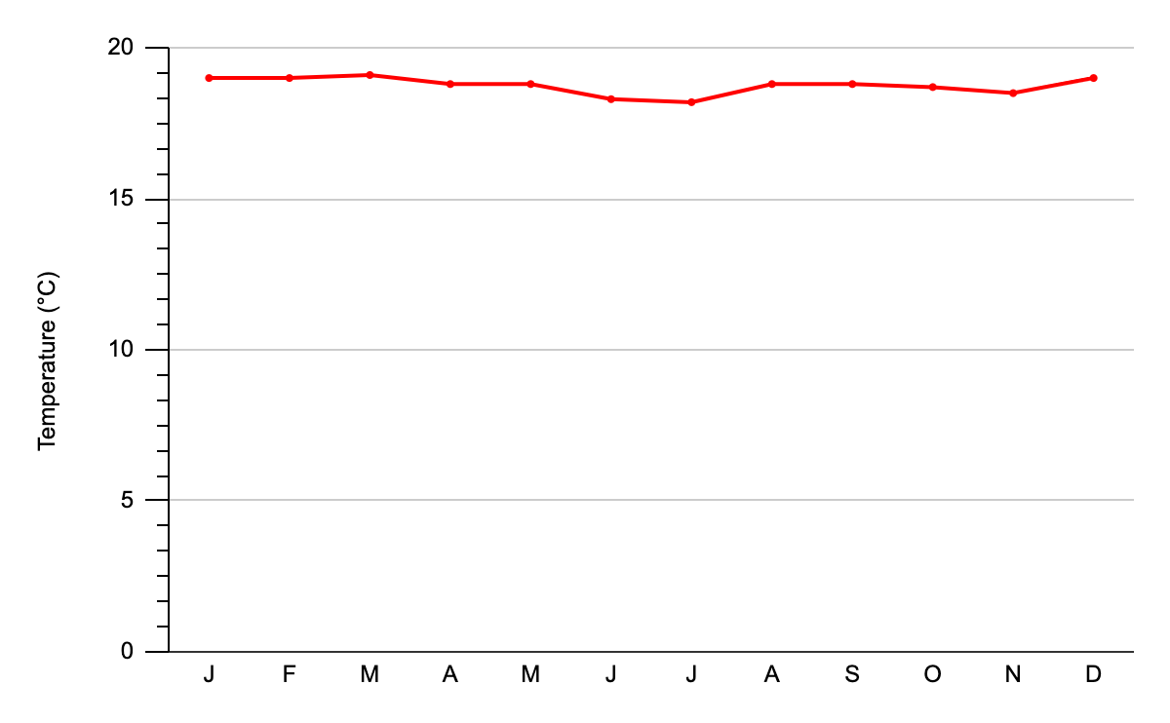
Notes:
Point out to students that even though the temperature in the climate graph on the left looks like it’s changing a lot, the scale is much smaller so really there are only small differences

Slide 14

#3: Proximity to a Body of Water
Places close to a body of water have more __________________ temperatures throughout the year
  This is called a maritime climate
Places far away from a body of water have more __________________ temperatures throughout the year
  This is called a continental climate
Why?
  Water heats and cools more slowly than land
  High specific heat capacity
Notes:
Constant / maritime
Warm summers and cool winters
Variable / continental
Hot summers and cold winters

Slide 15
#3: Proximity to a Body of Water
Which climate graph is from a location close to a body of water and which one is from a location far away from a body of water?
Notes:
Left: Far away from water, temperature is more variable
Right: Close to water, temperature is more constant

Slide 16
Practice for the Quiz

Slide 17
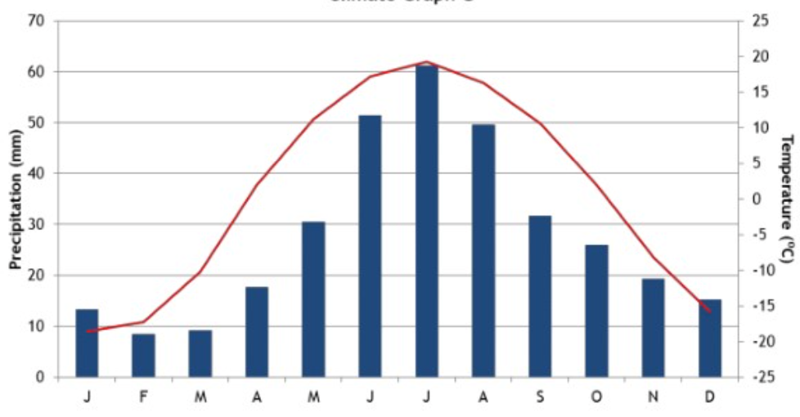
What is the average monthly precipitation in May? _______________________________
What is the temperature range for this city? _______________________________
Which hemisphere would this city be found in? _______________________________

Slide 18
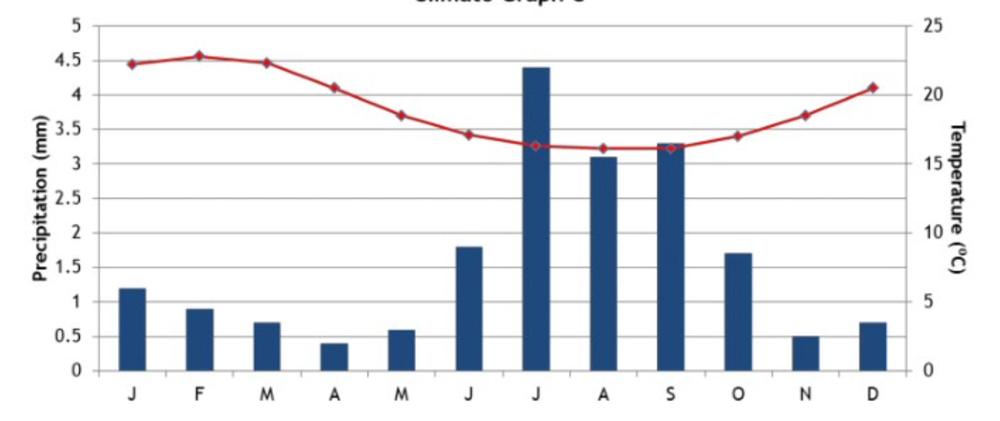
Which hemisphere would this city be found in? ________________________
Do you think this city is far from or close to the equator? ________________________
Do you think this city is far from or close to a body of water? ________________________

Slide 19
Why are Climate
Graphs Important?

Slide 20
Importance of Climate Graphs
Why do we use climate graphs? What can they tell us?
Notes:
Write the class’s answers on the screen
Predicting the weather in various places in different seasons
Tracking changes in climate over time
Evaluating the climate of a location, would you want to vacation there, would you want to live there?

Slide 21
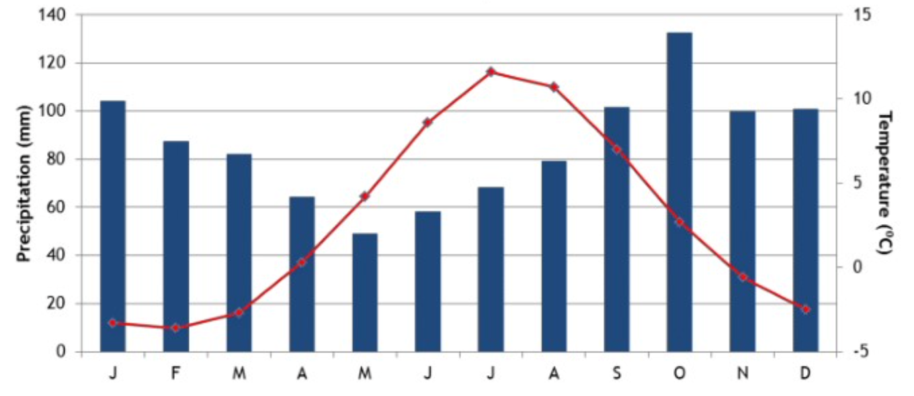
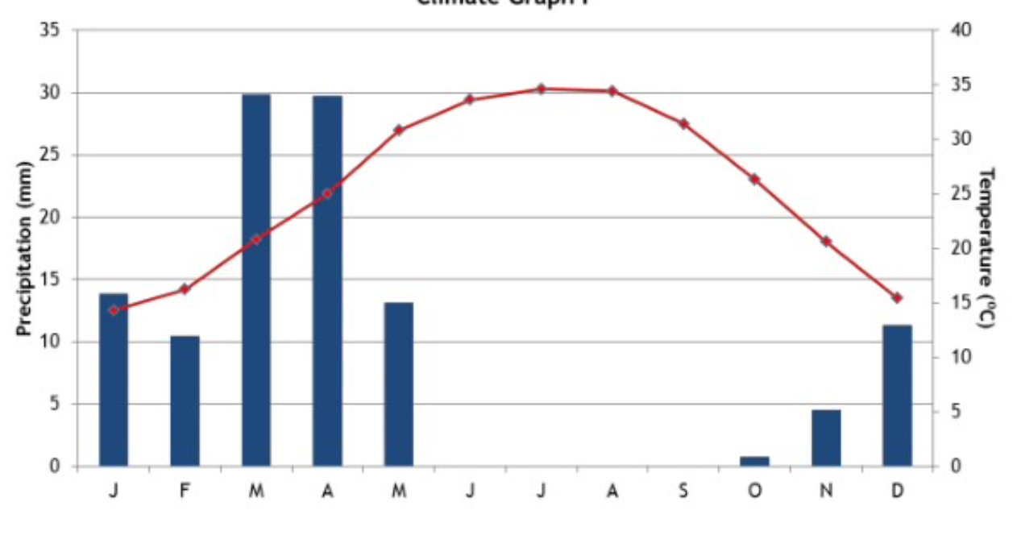
Where would you prefer to live?

Slide 22
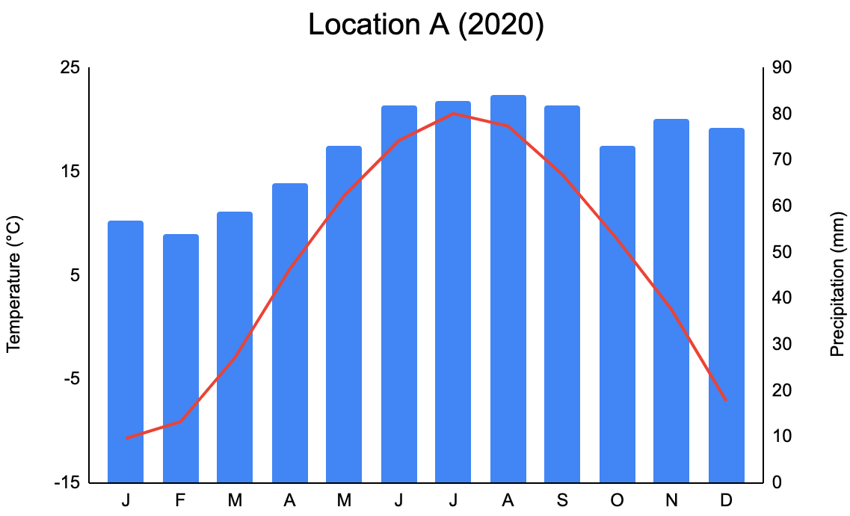
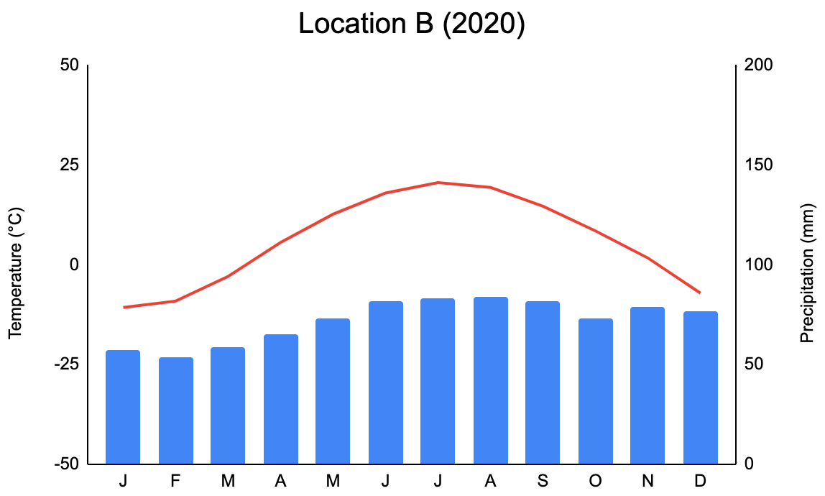
Where would you prefer to live?
Notes:
Both are Ottawa!

Slide 23
Quiz!

Slide 24
Let’s Make a Climate Graph Together

Slide 25
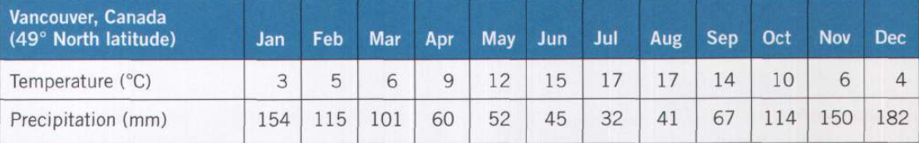

Notes:
Top: Location, year, and latitude
Bottom: Months of the year
Left: Temperature scale
0 - 20 °C
Right: Precipitation scale
0 - 200 mm

Slide 26
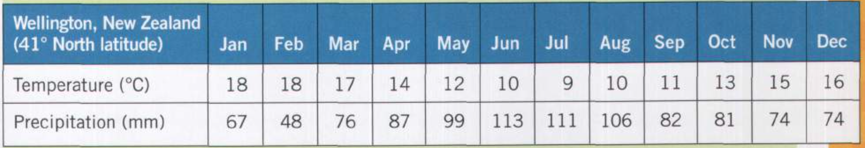
Part 1: Make Your Own Climate Graph
Key elements...
  Top: Location and year
  Bottom: Months
  Line graph in red (average temperature for each month)
  Left: Scale for average temperature (°C)
  Bar graph in blue (total precipitation for each month)
  Right: Scale for total precipitation (mm)

Slide 27
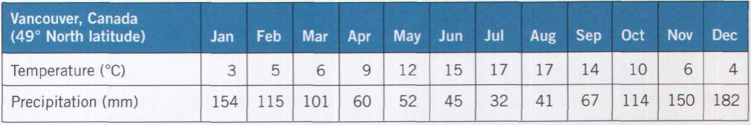
Part 2: Make Your Own Climate Graph
Now we’re going to make climate graphs online
Go to Mr. Fitch’s climate graph page and click on the photo of a climate graph to see the instructions for making a climate graph online
Once you are finished: Take a screenshot, rename the file as your name, and email it to Mr. Fitch (dave.fitch@ocdsb.ca)
Notes:
http://www.downwindkennels.com/me/SubjectLinks/geography/gr7patternsphysicalgeo/climategraph.html
http://www.downwindkennels.com/me/SubjectLinks/geography/gr7patternsphysicalgeo/barlinegraphtool.html

