Slide 1


Financial Literacy

Slide 2
Definitions
Definitions Advanced
Sales
Sales Tax
Interest
100
200
100
100
100
200
400
200
200
200
300
600
300
300
300
400
800
400
400
400
500
1000
500
500
500

Slide 3
Definitions – 100
A plan to balance income and expenses.
A: What is a budget?

Slide 4
Definitions – 200
A loan used to buy a home or land.
A: What is a mortgage?

Slide 5
Definitions – 300
A financial charge that funds government spending.
A: What is a tax?

Slide 6
Definitions – 400
Money that is owed or due.
A: What is debt?

Slide 7
Definitions – 500
The trust between a lender and the borrower.
A: What is credit?

Slide 8
Definitions Advanced – 200
Money spent on necessities.
A: What are expenses?

Slide 9
Definitions Advanced – 400
Money that is borrowed that you pay back with interest.
A: What is a loan?

Slide 10
Definitions Advanced – 600
The value of one country’s currency compared to another’s.
A: What is an exchange rate?

Slide 11
Definitions Advanced – 800
A fixed amount of money paid to an employee.
A: What is a salary?

Slide 12
Definitions Advanced – 1000
A percentage of a sale received by the salesperson.
A: What is a (sales) commission?

Slide 13
Sales – 100
$50 at $10 off
A: What is $40?

Slide 14
Sales – 200
$20 at 25% off
A: What is $15?

Slide 15
Sales– 300
2 items for the price of 1
A: What is Buy
One Get One Free?

Slide 16
Sales – 400
A $50 biker shirt is discounted 25% off.
A: What is $37.50?

Slide 17
Sales – 500
$48.29 at 18% off
A: What is $39.60?

Slide 18
Sales Tax – 100
The sales tax (HST) in Ontario.
A: What is 13%?

Slide 19
Sales Tax – 200
$100 plus tax
A: What is $113.00?

Slide 20
Sales Tax – 300
$50 plus tax
A: What is $56.50?

Slide 21
Sales Tax – 400
$79.99 plus tax
A: What is $90.39?

Slide 22
Sales Tax – 500
$459.29 plus tax
A: What is $519.00?

Slide 23
Interest – 100
The amount of money in a savings account with a principal of $10 000 and an interest rate of 3% after 0 years.
A: What is $10 000?

Slide 24
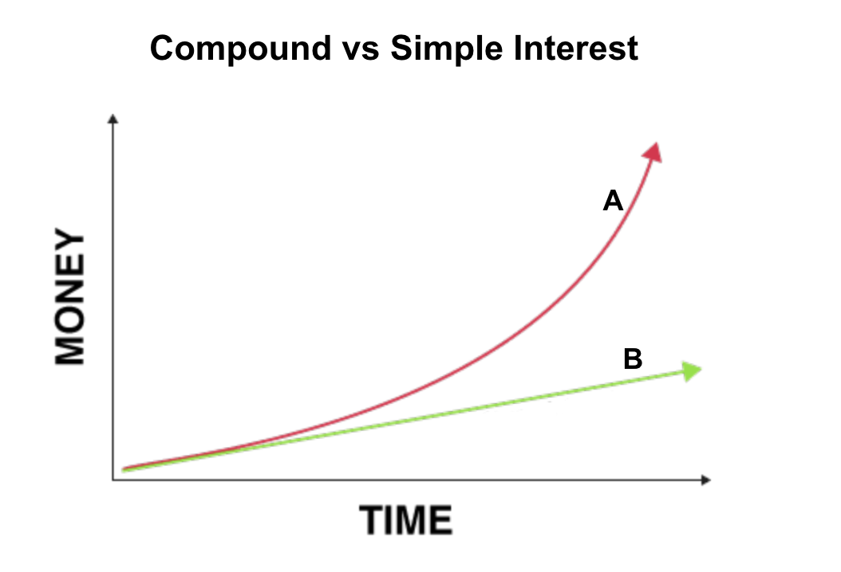
Interest – 200
Line B is this kind of interest.
A: What is simple interest?

Slide 25
Interest – 300
The smarter investment between compound and simple interest for a savings account.
A: What is compound interest?

Slide 26
Interest – 400
A simple interest savings account that pays annually with a principal of $500 and 10% interest will grow by this much every year.
A: What is $50?

Slide 27
Interest – 500
The amount of money in a savings account with a principal of $1000 and an annual compound interest rate of 10% after 3 years.
A: What is $1331?

Slide 28
Final Jeopardy Category:
$ € £ ¥ ₽ ฿
Currency

Slide 29
Currency – Final Jeopardy
The countries that use the Yen, Yuan, Pound & Peso.
A: What are Japan, China, the UK & Mexico (The Philippines, Chile, Cuba, Colombia, Dominican Republic, Argentina, Uruguay. Egypt also has the pound)

