Slide 1
The pH Scale

Slide 2
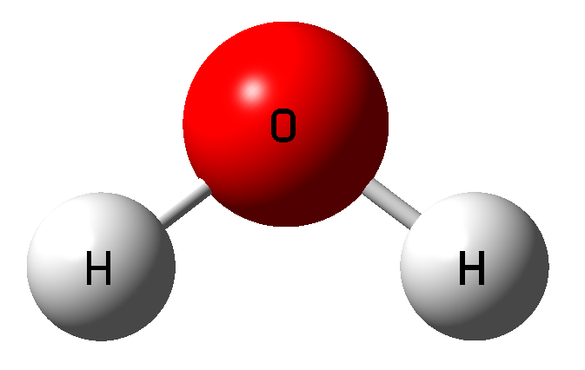
What is the chemical formula (makeup) of water?
What does the pH scale describe?
What does pH stand for?
H₂O
How acidic or basic a substance is
pH = Potential of hydrogen

Slide 3
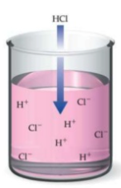
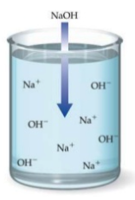
When an acid is dissolved in water, H⁺ ions are created.
  Ex: Hydrochloric acid (HCl)
When a base is dissolved in water, OH⁻ ions are created.
  Ex: Sodium hydroxide (NaOH)

Slide 4
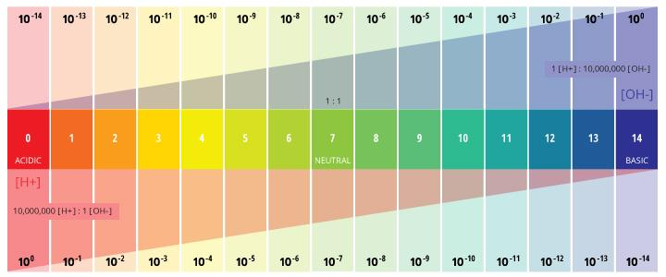
Moving DOWN the pH scale = The solution is more ACIDIC
  Are there more or less H⁺ ions?
  Are there more or less OH⁻ ions?
Moving UP the pH scale = The solution is more BASIC
  Are there more or less H⁺ ions?
  Are there more or less OH⁻ ions?
MORE
LESS
LESS
MORE

Slide 5
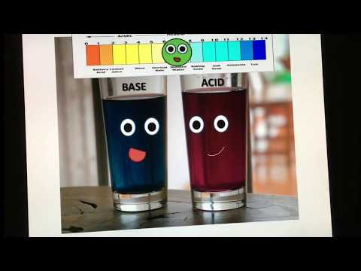
Notes:
https://www.youtube.com/watch?v=gRZ-2IbLd34&t=34s

Slide 6
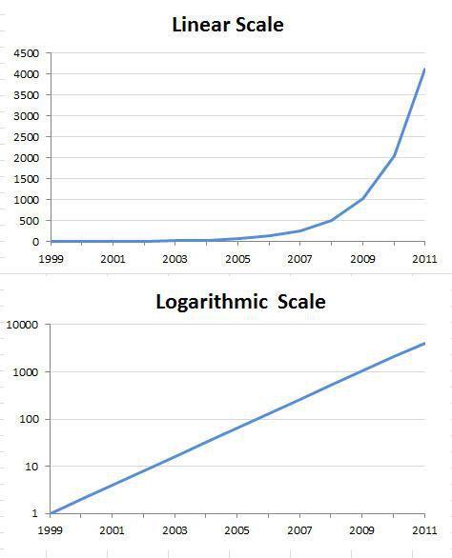
Logarithmic Scale
The pH scale is not a regular scale, it’s logarithmic.
Logarithms are used to help us understand very large numbers.

Slide 7
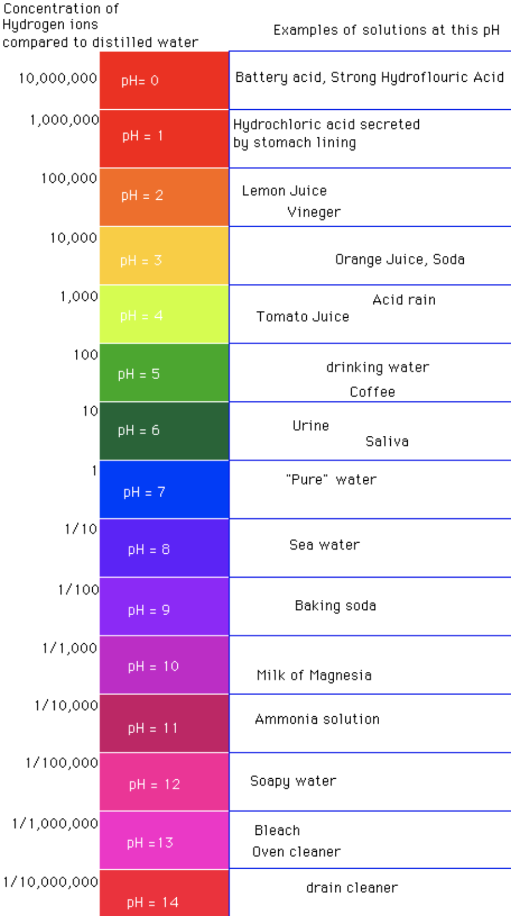
Logarithmic Scale
An increase or decrease by 1 integer on the pH scale corresponds to a 10-fold change in the concentration of H⁺.
Ex 1: A solution at a pH of 6 is 10 times more acidic than a solution at a pH of 7.
Ex 2: A solution at a pH of 2 is 100 (10 x 10) times more acidic than a solution at a pH of 4.
Ex 3: A solution at a pH of 10 is 1000 (10 x 10 x 10) times more basic than a solution at a pH of 7.

Slide 8
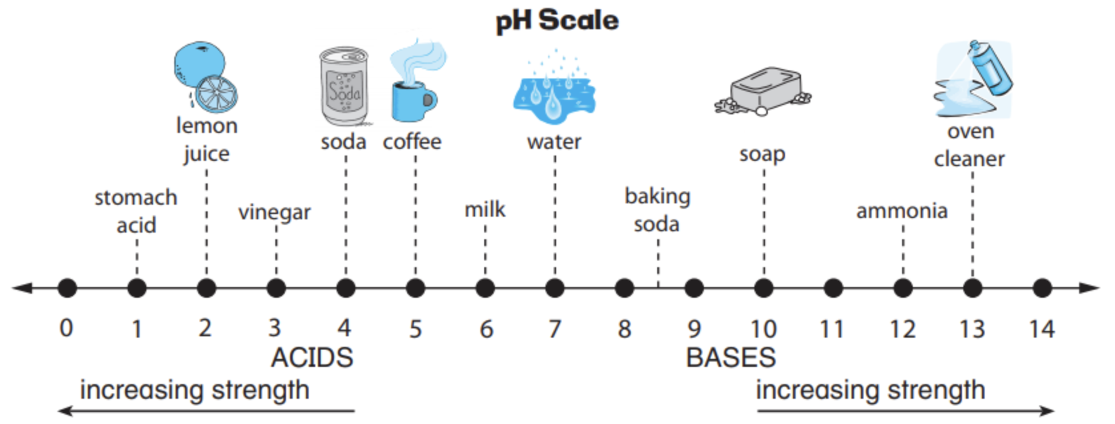
Calculations
1. Milk is how much more acidic than water?
Notes:
Milk = 6
Water = 7
10 times more acidic

Slide 9
Calculations
2. Lemon juice is how much more acidic than milk?
Notes:
Lemon juice = 2
Milk = 6
10 x 10 x 10 x 10 = 10,000 times more acidic

Slide 10
Calculations
3. Soap is how much more basic than water?
Notes:
Soap = 10
Water = 7
10 x 10 x 10 = 1,000 times more basic

Slide 11
Calculations
4. Oven cleaner is how much more basic than soda?
Notes:
Oven cleaner = 13
Soda = 4
10 x 10 x 10 x 10 x 10 x 10 x 10 x 10 x 10 = 1,000,000,000 times more basic

Slide 12
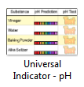
pH Experiment
We’re going to perform the Universal Indicator experiment from our class website to learn about the pH of everyday substances.
Notes:
http://www.downwindkennels.com/me/SubjectLinks/science/substances/substances.html

Slide 13
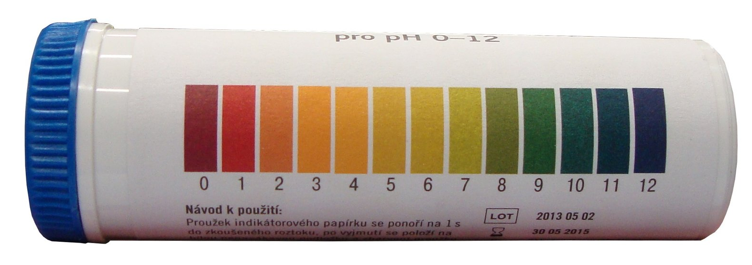
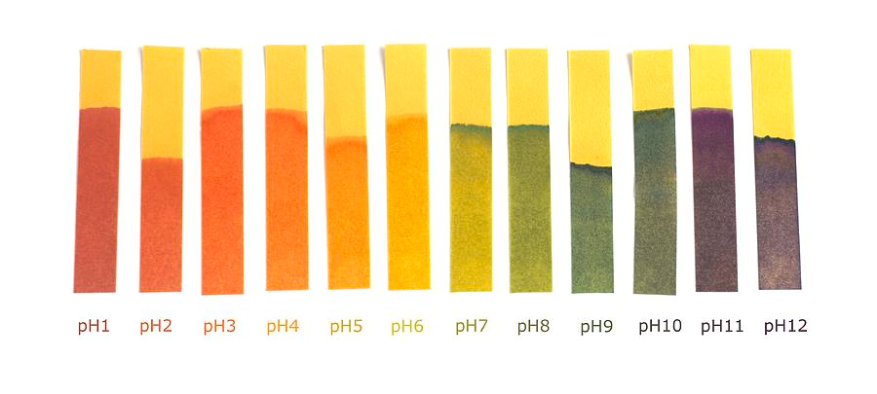
Universal Indicator Paper
The video we watched earlier discussed litmus paper.
  Acids turn litmus paper RED and bases turn litmus paper BLUE.
Although, another kind of pH paper called universal indicator paper exists that is more specific.

